Slide 1


Slide 2

NLP Chatbot Development using Dialogflow

Slide 3
Group Members Introduction
F24PROJECT8DE28
Samer Yousaf
BC210415622

Slide 4

INTRODUCTION OF PROJECT
Chatbots are increasingly becoming integral to industries such as customer service, e-commerce, healthcare, and education.
In this project, students will develop a chatbot using Google Dialogflow, an NLP-powered conversational interface.
The chatbot should address a specific business need by automating customer interaction, providing relevant responses, and enhancing user experience.
Students can select a case study from one of three industries: Training Company, Pharmacy Store, or Restaurant

Slide 5
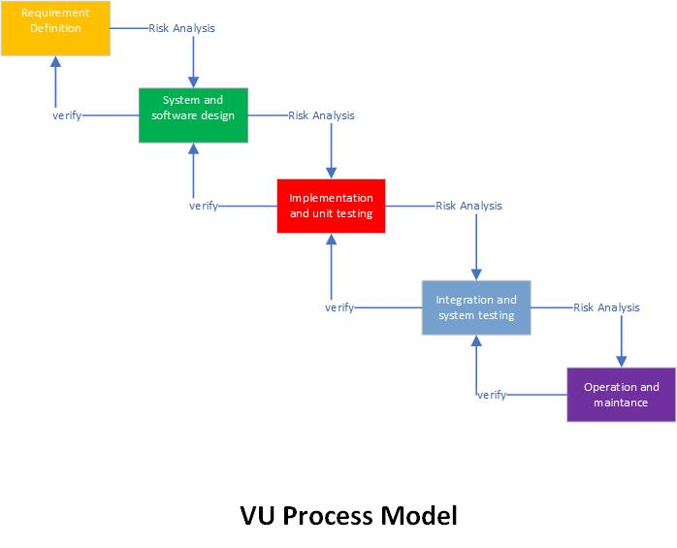
Adopted Methodology

Slide 6
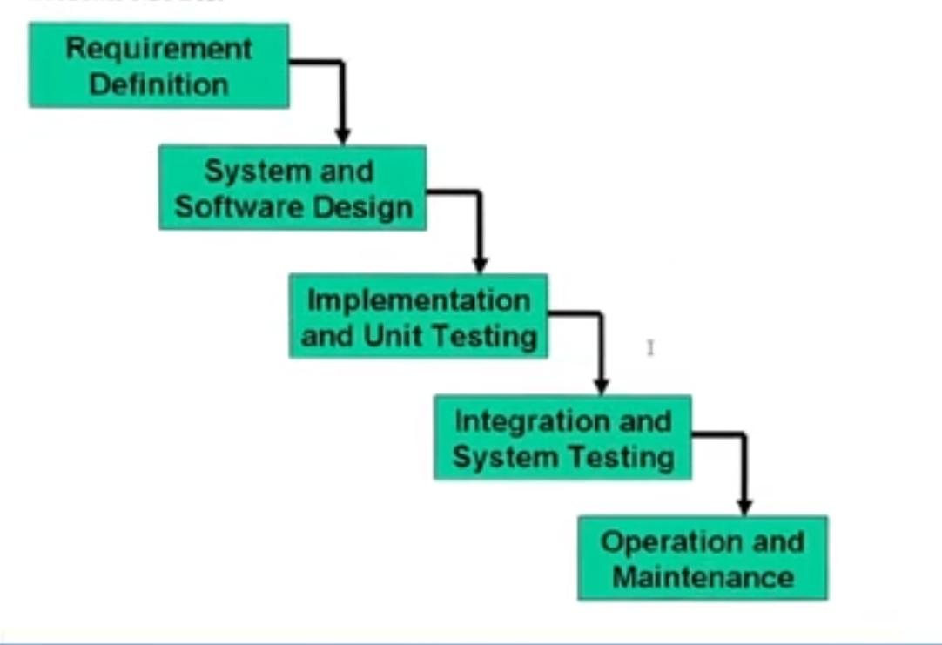
Adopted Methodology
Waterfall Model

Slide 7
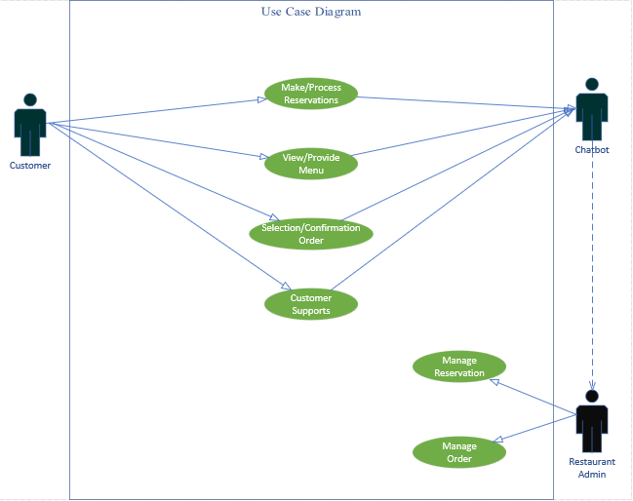
Use Case Diagram

Slide 8
Business Rules Catalog
The chatbot must greet users with a welcome message and ask how it can assist.
The chatbot must always use polite and friendly language.
Restaurant: A chatbot that handles table reservations, order-taking, menu navigation, or customer support.

Slide 9
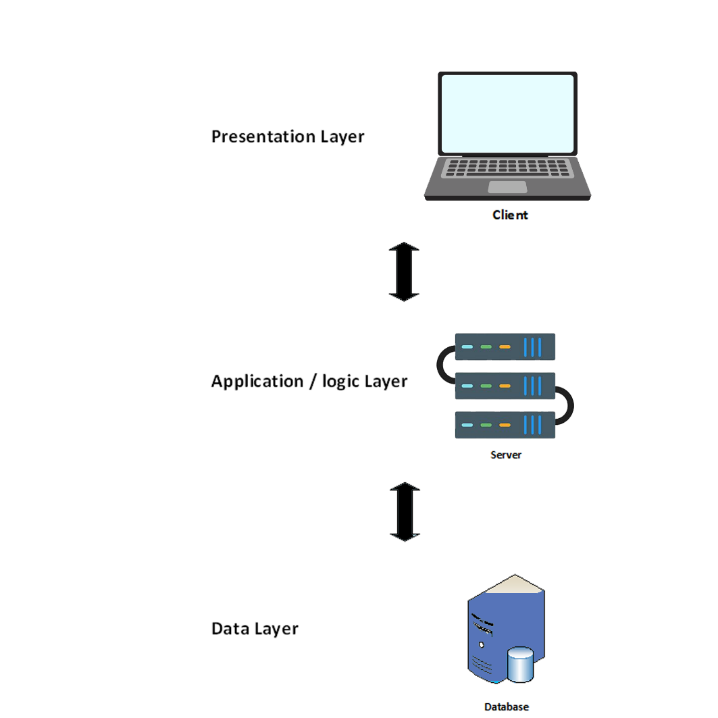
Architectural Design

Slide 10
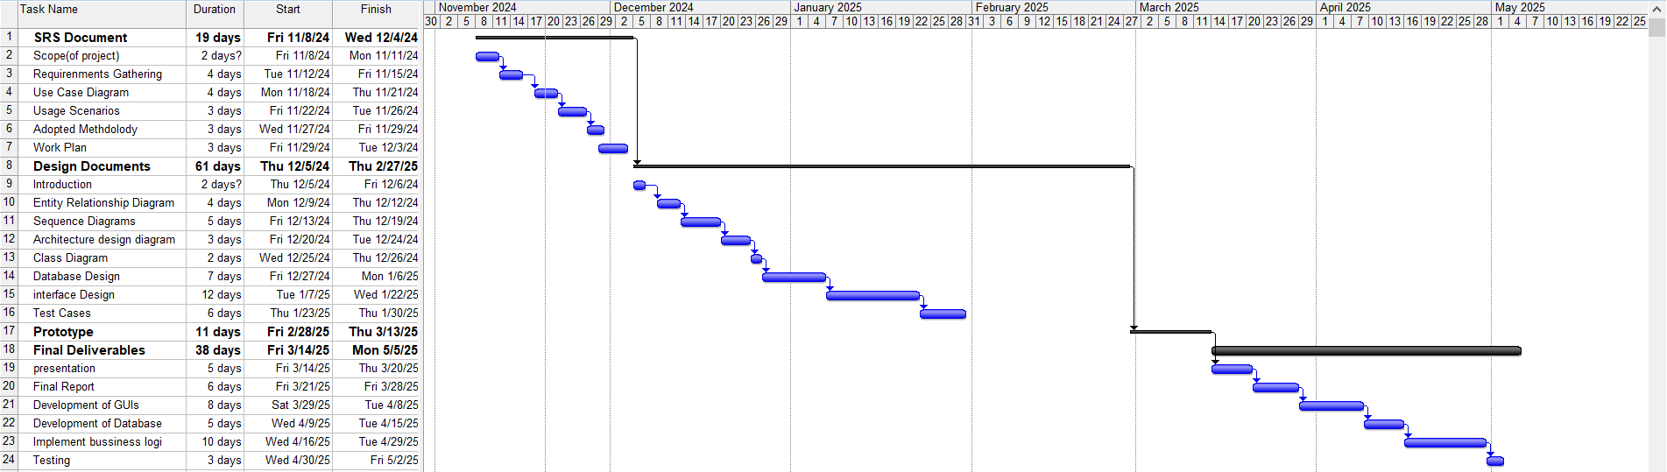
Project Schedule

Slide 11
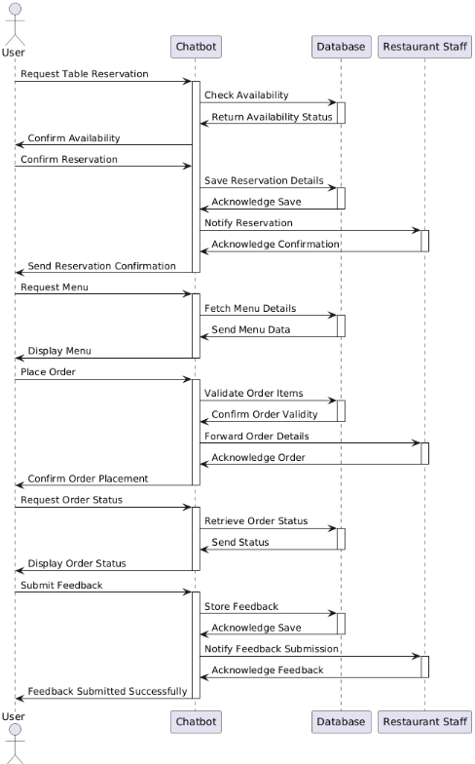
SEQUENCE DIAGRAMS

Slide 12
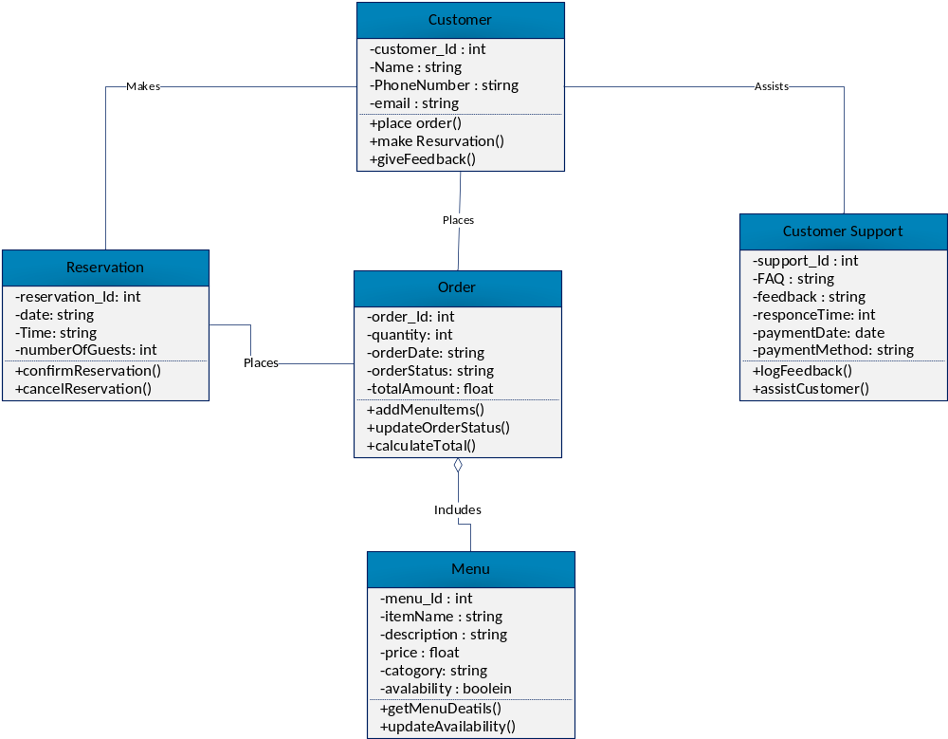
Logical Model/Class Diagram

Slide 13
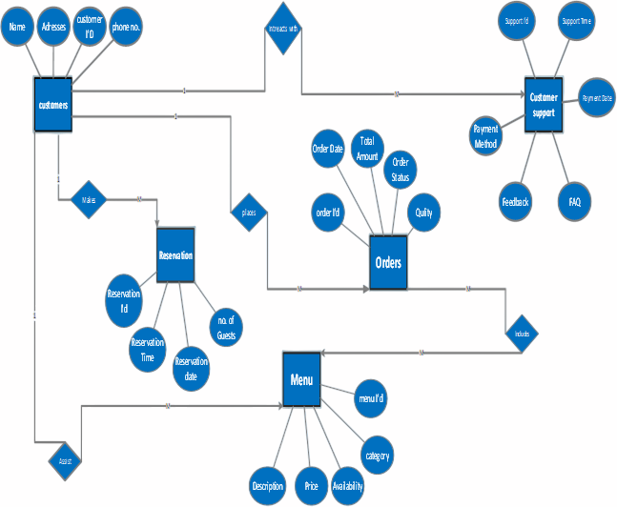
Entity-Relationship Diagram

Slide 14
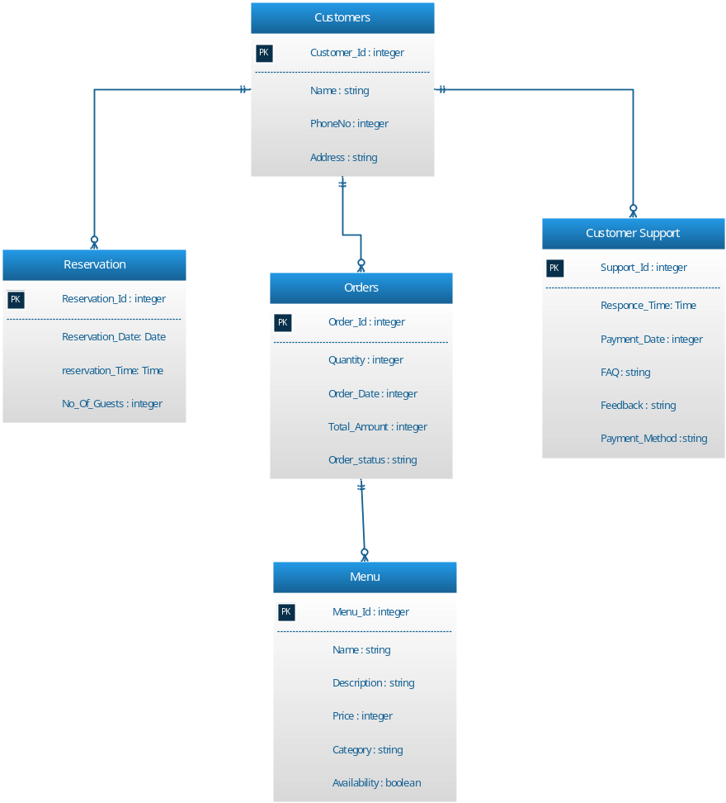
Database Diagram

Slide 15
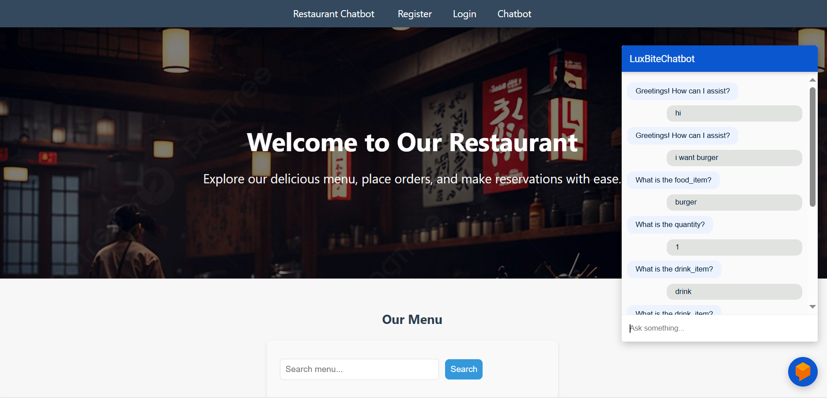
Interfaces of Home Page

Slide 16
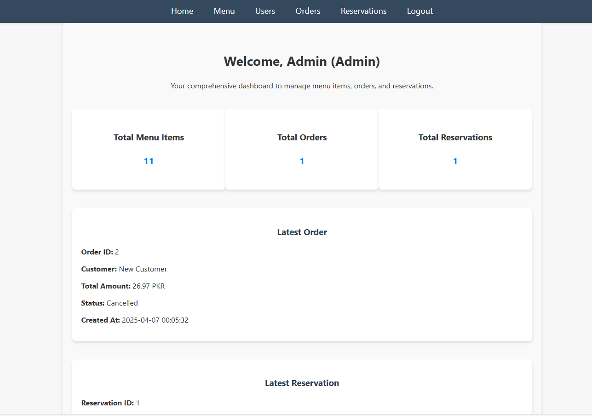
Admin Dashboard

Slide 17
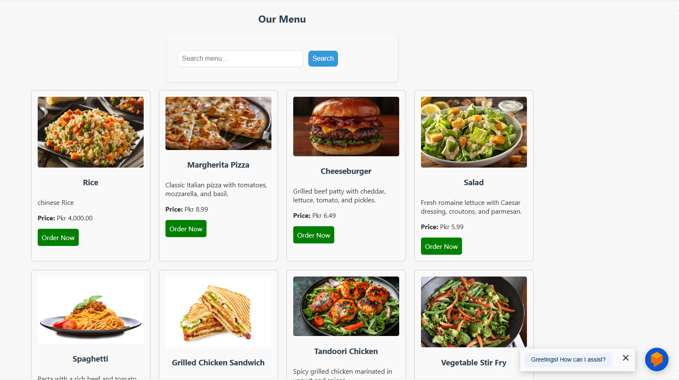
Menu Items

Slide 18
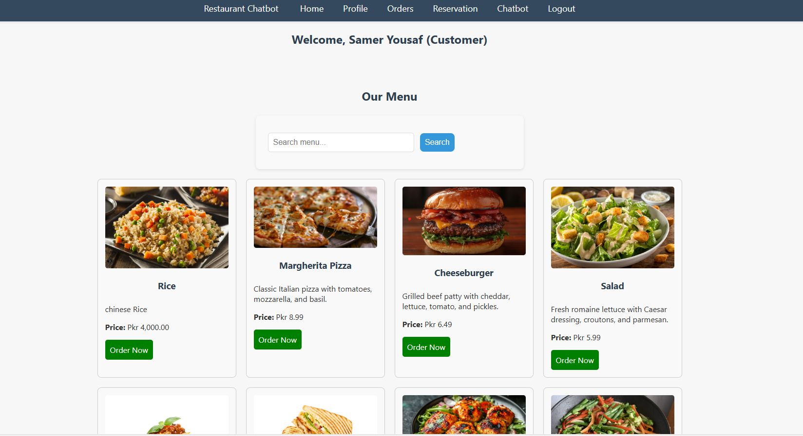
Customer Login Panel

Slide 19
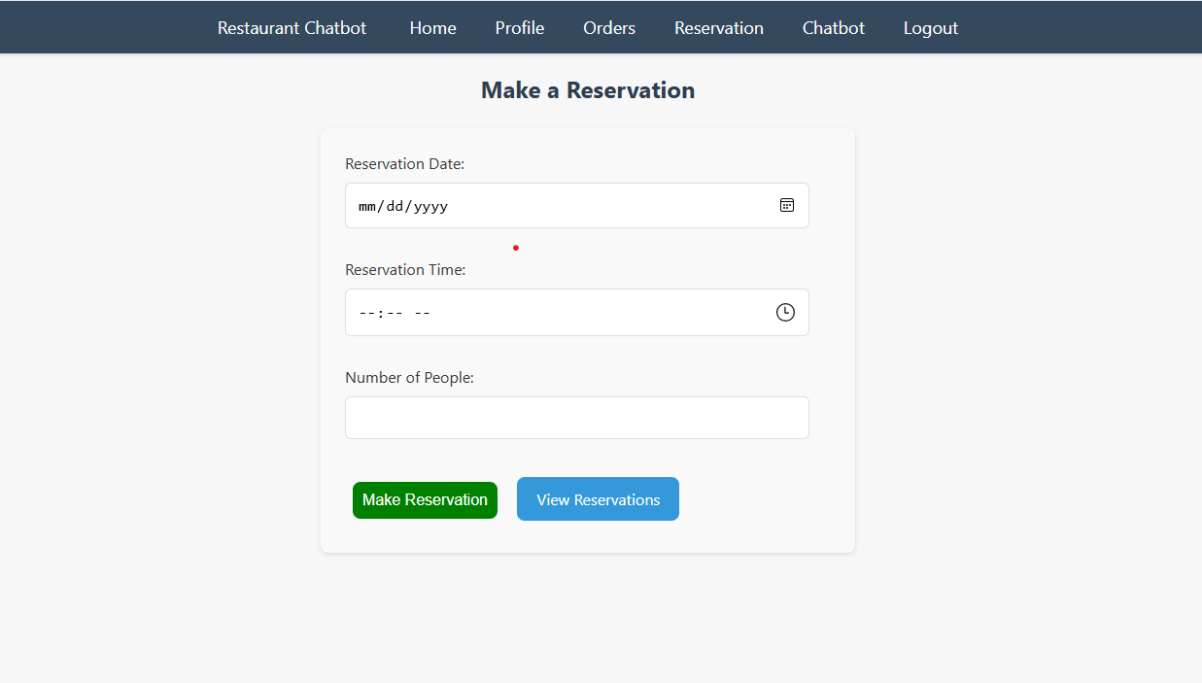
Make Reservation

Slide 20
Tools
HTML
PHP
CSS
BOOTSTRAP
JAVASCRIPT

